Slide 1
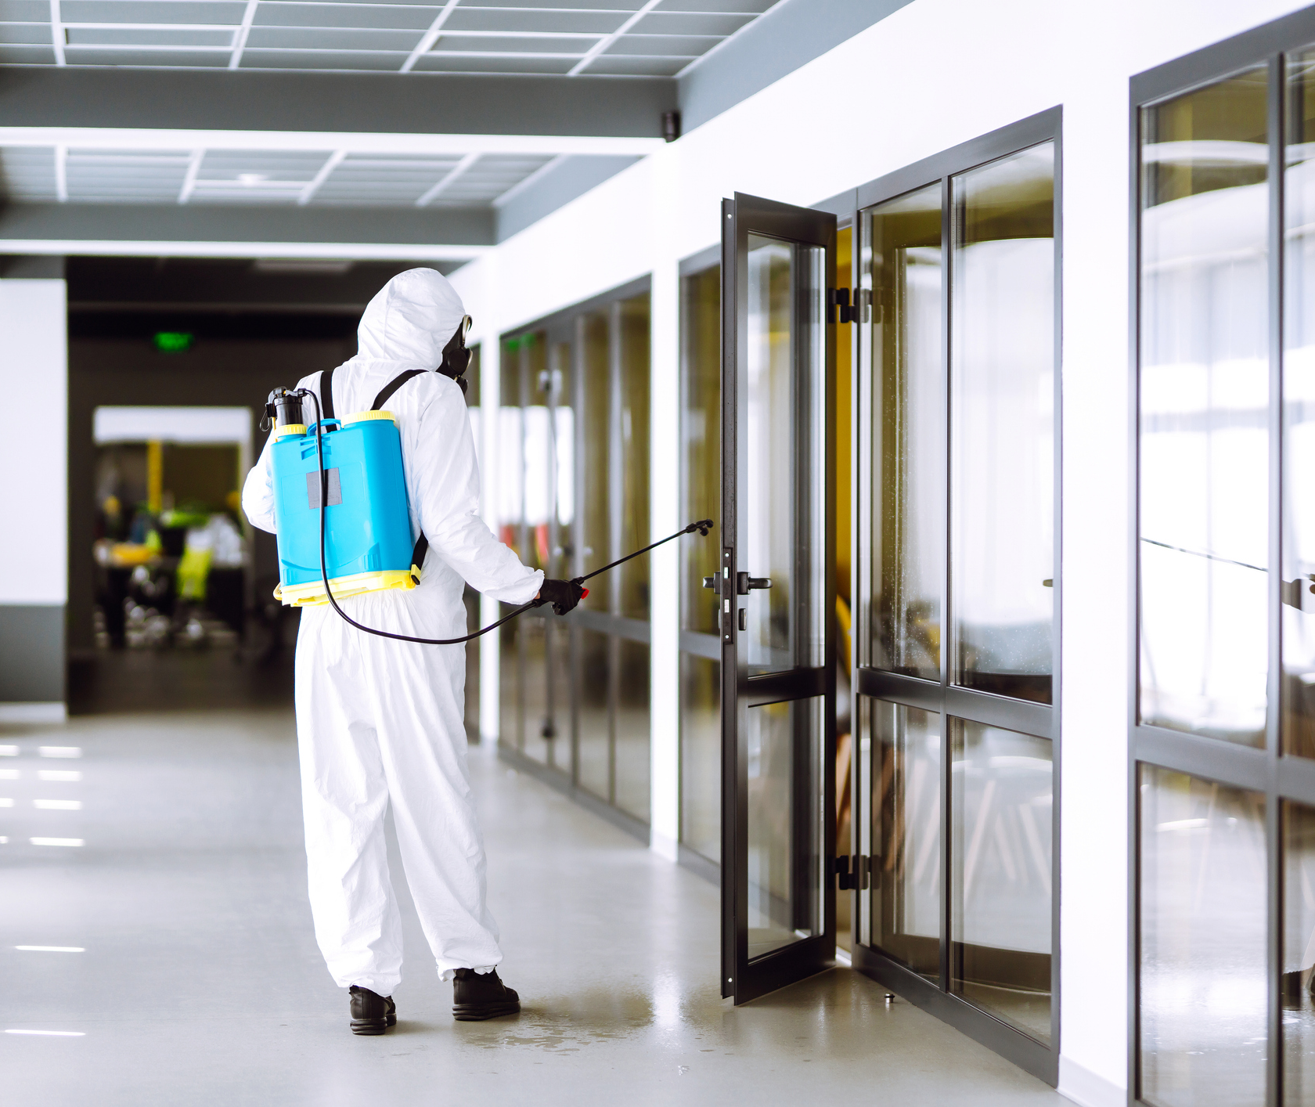
ERICA: Empowering Experts in CBR Site Decontamination
ISMOR 42
Mike Walker
This document has been prepared solely for ISMOR
and may not, without permission, be disclosed to any third party.
Author/s: Mike Walker
© Sagentia Defence 2025

Slide 2
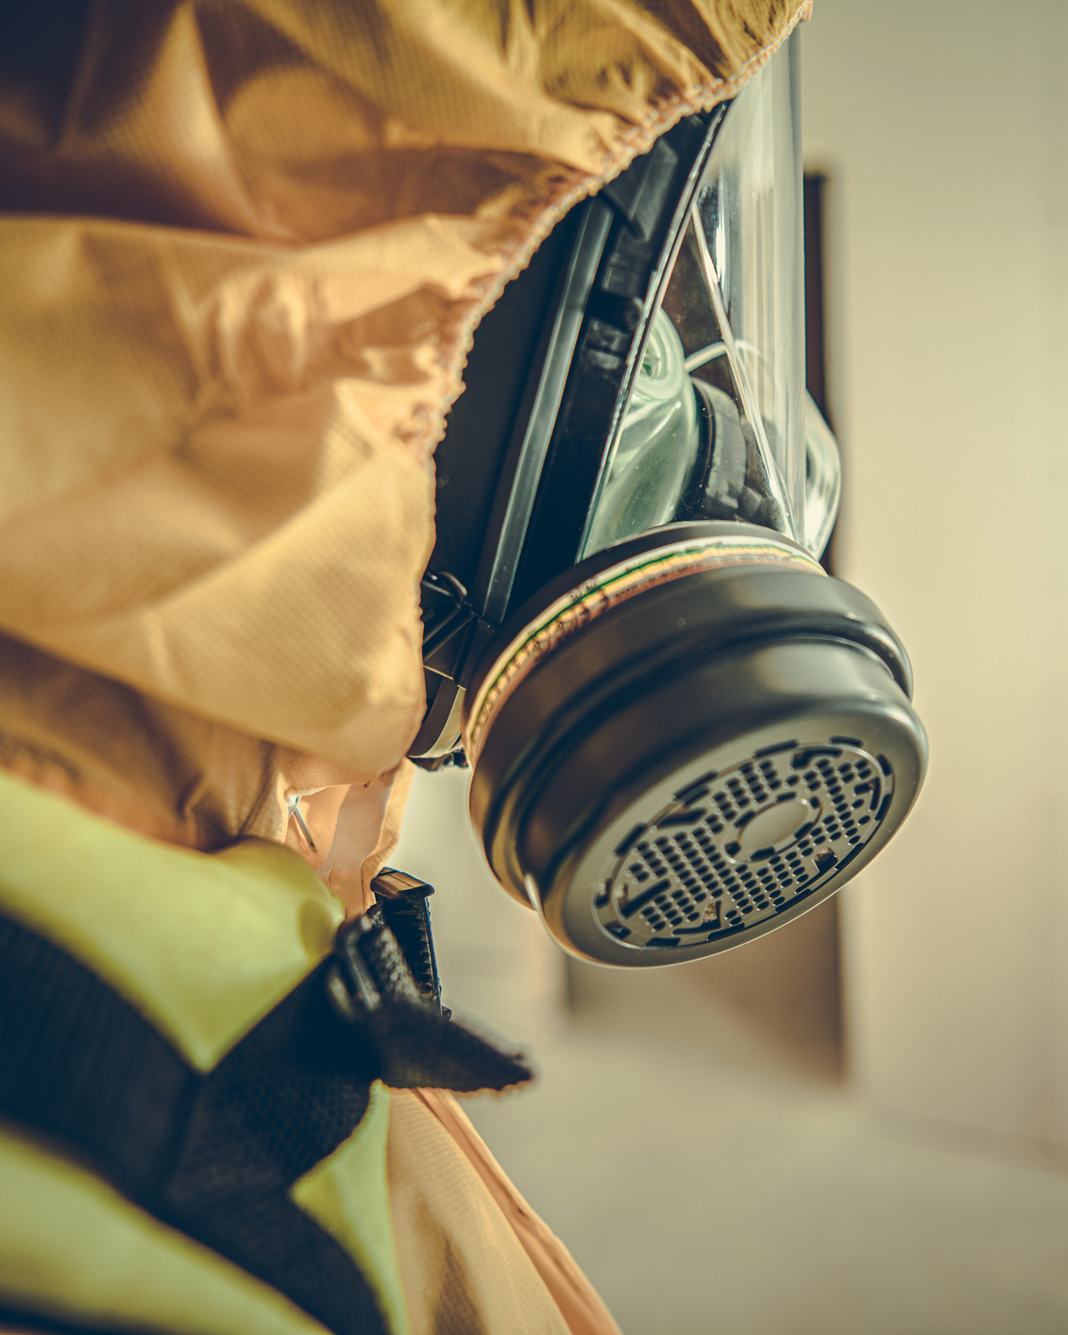
Introduction
  Background
  Requirement
Overview of CBR Recovery
  Scope
  Recovery Activities
  Remediation
How ERICA works
  The ERICA toolset
  Database of “Building Blocks”
  Choosing a Remediation Plan
  Discrete-Event Simulation
  Results Dashboard
Looking Ahead

Slide 3
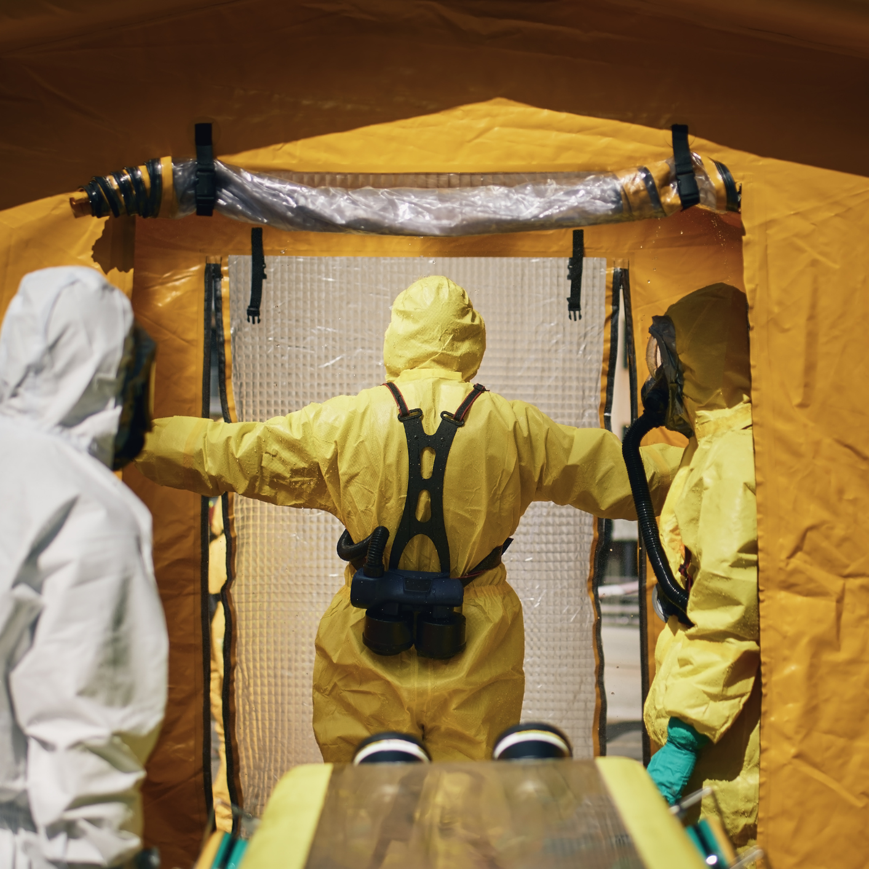
Introduction

Slide 4
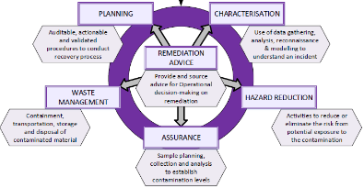
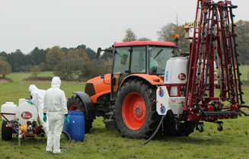
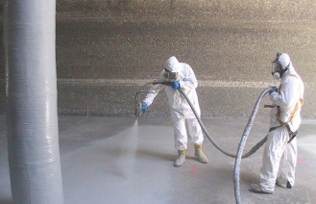
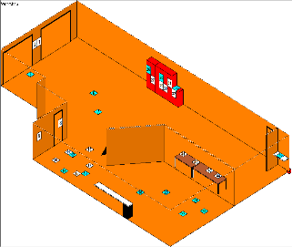
Background
National Technical Advisory Group for chemical, biological or radiological Recovery (NTAG-R) is a collaboration between DEFRA and Dstl to drive the development of tools, techniques and capabilities to recover an incident site contaminated with chemical, biological or radiological (CBR) materials.
The NTAG-R provides authoritative technical advice on:
Under NTAG-R, Sagentia Defence are delivering the Environmental Recovery Involving CBR Agents (ERICA) toolset.
Collection of technical data and establishing recovery requirements.
Developing and qualifying technology options.
Work with providers and integration of new technology and techniques.
Building and developing models, simulations and tools to support recovery operations.

Slide 5
Requirement
The original request in 2021 was to build a simulation of the recovery process to support stockpiling strategies.
  Sagentia built a Simul8 model of the recovery process.
  The focus was on the number of consumables used, consumable cost, and recovery time.
  Dstl and DEFRA intended to use ERICA to explore and optimise consumable stockpiles.
This initial model scratched the surface of the problem, but further value could be gained:
  Can the toolset assist analysts with the massive input data burden?
  Can the simulation be more flexible (types of consumable, priorities, resource numbers, supporting resources, etc)?
  Can the simulation be used to provide operational advice and evidence?
  Can ERICA integrate data from trials and repositories?
  What other data and insights can be gathered from the recovery simulation?
DEFRA, Dstl and Sagentia worked together to evolve ERICA’s scope and requirements, providing what is now a very powerful and flexible operational analysis toolset, covering both strategic planning and support to operations.

Slide 6
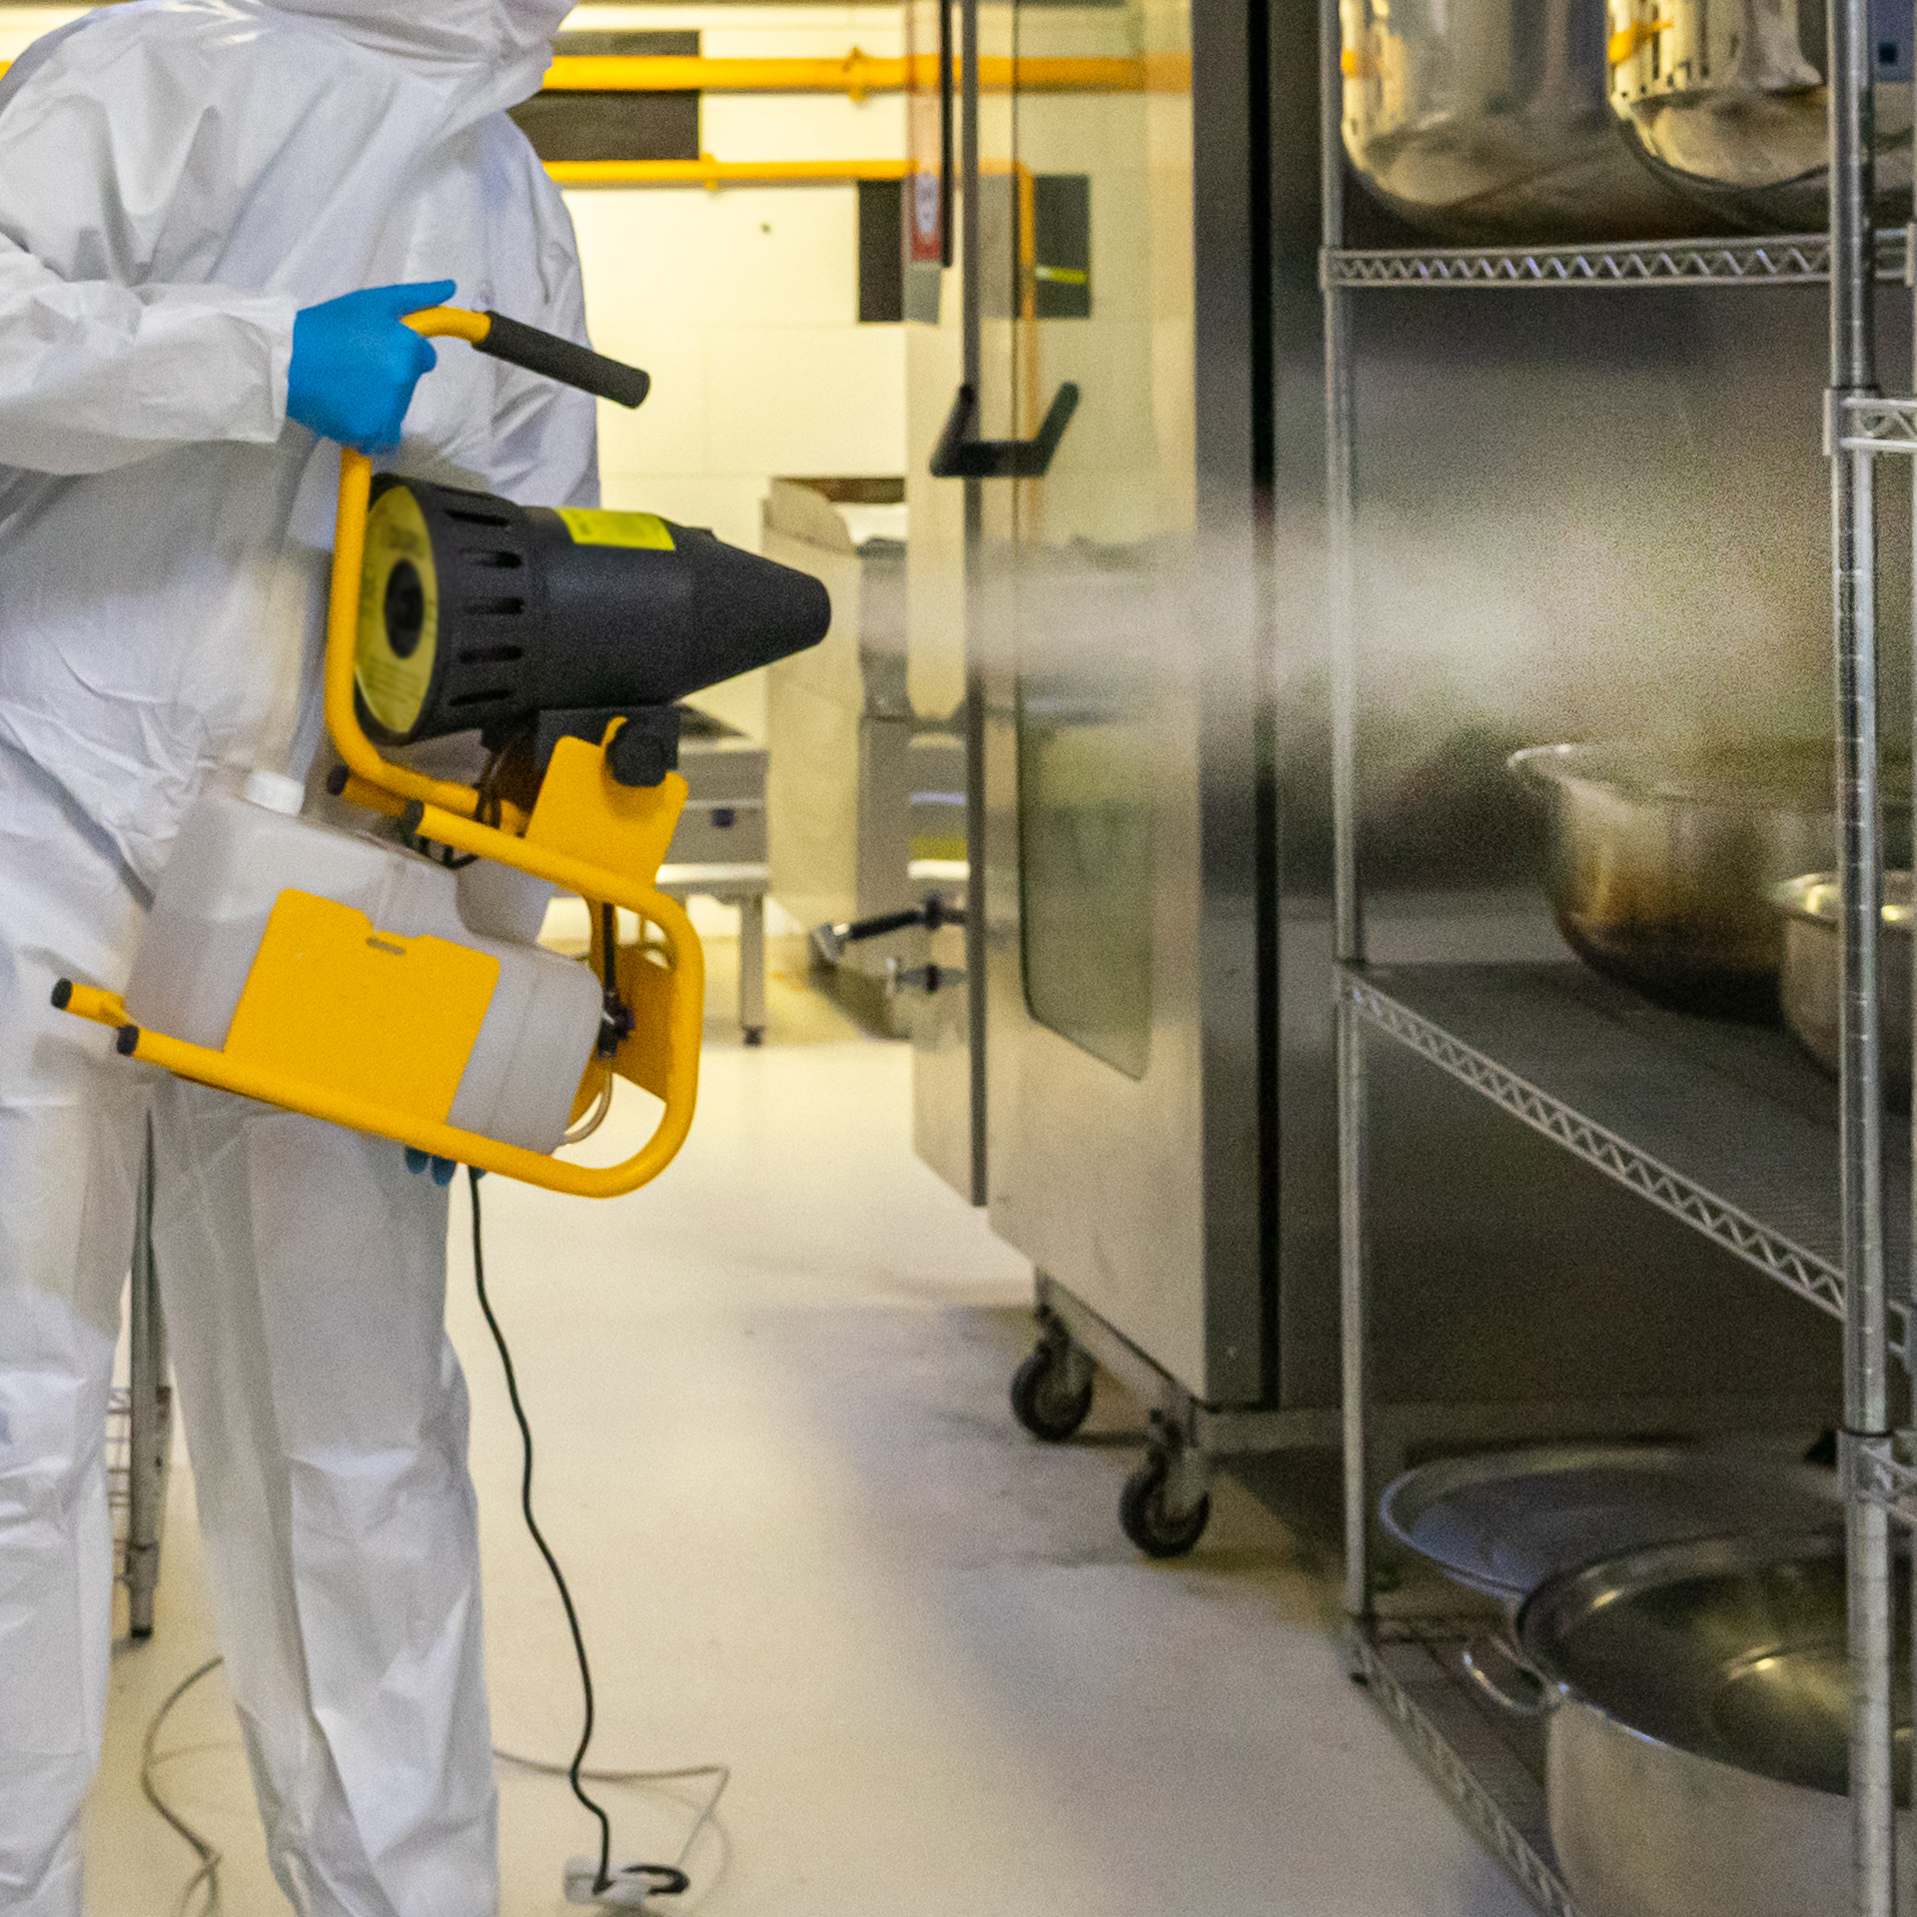
Overview of CBR Recovery

Slide 7

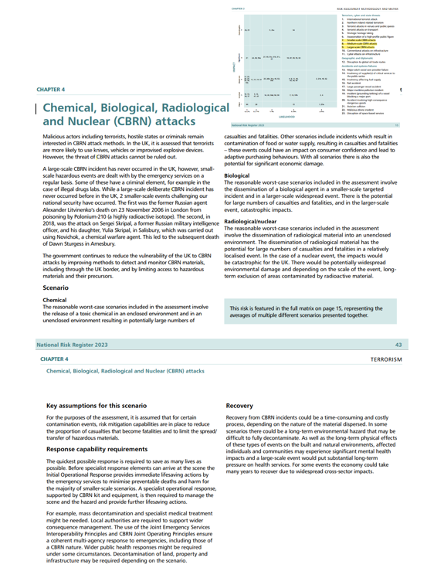
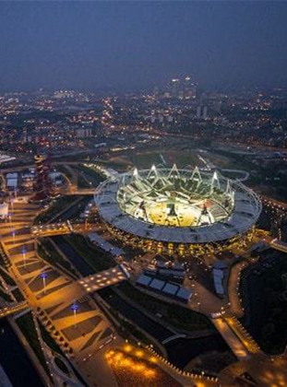
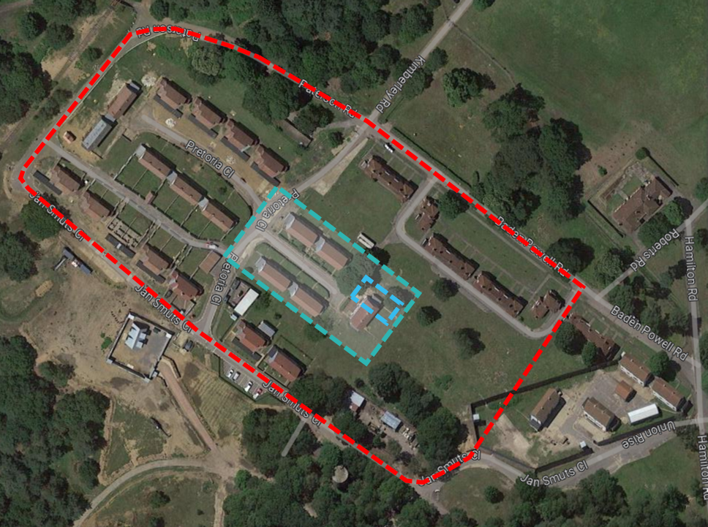
Scope
Scope of the recovery activities, simulated by ERICA:
  Start: A site is contaminated with a CBR material and has been cordoned off by the response phase.
  End: A site is confirmed safe from the CBR hazard, through cleaning or disposal of contaminated items.
A Site may be a large location, as outlined in the scenarios of the National Risk Register.
  To provide a valuable assessment of a contaminated site, a detailed understanding of the site is necessary.
Risk 7 (Small Scale):
e.g. Targeted CBRN incident on a residential estate
Risk 9 (Large Scale):
e.g. CBRN incident impacting a sporting event and surrounding area
Risk 8 (Medium Scale):
e.g. CBRN incident during a concert / sporting event

Slide 8
Recovery Activities
ERICA models 14 sequential activities that must be completed to recover a site, but for this talk we can simplify this to:
  Planning ➔ site survey ➔ sample collection and processing ➔ remediation ➔ confirmation sampling
Activities may have different requirements to be undertaken:
  Time – every activity has a completion time, which may be input directly or calculated.
  Resources – teams of people or re-useable equipment:
    Workers,
    Subject Matter Experts (SMEs),
    Fumigator equipment.
  Consumables – items that are expended:
    Personal Protective Equipment (PPE),
    Cleaning/decontamination products,
    Sample collection jars.
Planning
Sample collection & processing
Remediation
Site survey
Confirmation sampling
Initial disposal

Slide 9
Remediation
Remediation is the process of making the site safe by conducting a combination of:
  Applying a treatment technology to neutralise or remove the CBR contaminant:
    Surface-application – e.g. scrubbing, spraying of internal and external spaces.
    Volume-application – e.g. fumigation of an internal space.
  Disposal of items:
    Too difficult to remediate.
    Too fragile to remediate.
    Replacing the item is more straightforward than remediation.
There may be a broad and complex list of potential options for the CBR expert to consider:
  Effectiveness may vary depending on the material of the item and the contaminant.
  Effectiveness of a decontamination option may decrease after repeated treatments of the same type.
  May be special requirements/equipment/expertise required to support deployment of that technology.
  Some options may be mature techniques whereas others may be more speculative and uncertain.
A challenging problem-space for the analyst to keep in their head when making decisions!

Slide 10
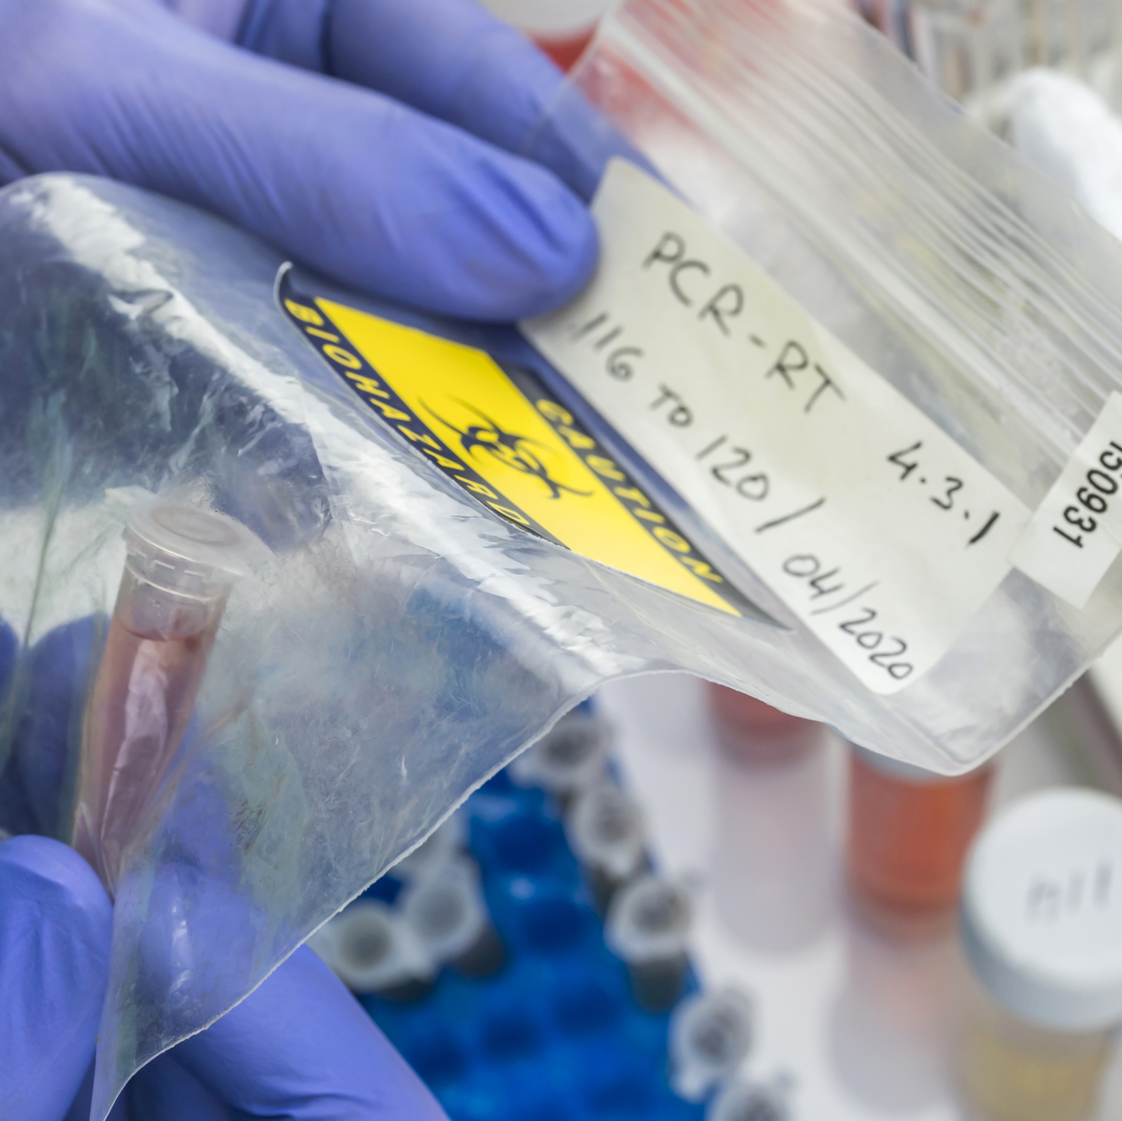
How ERICA works

Slide 11
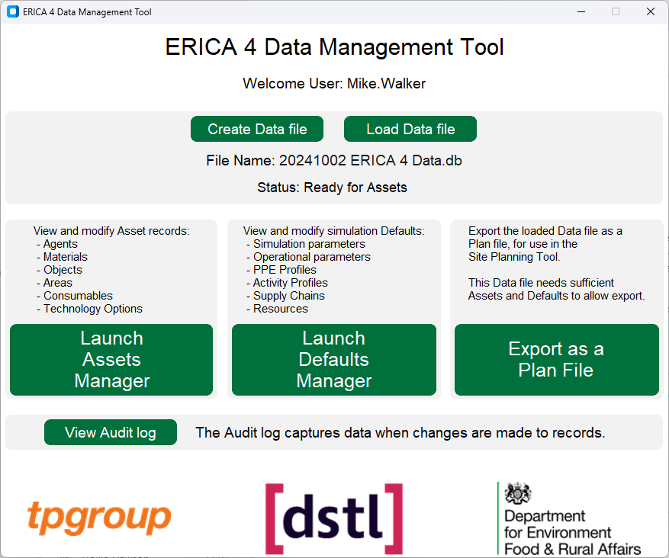
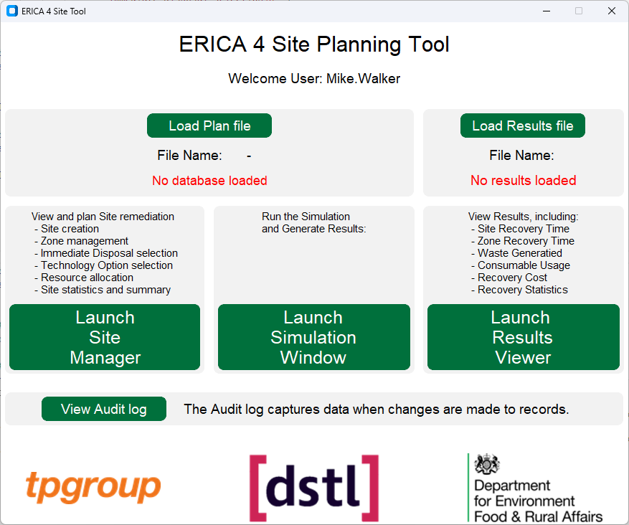

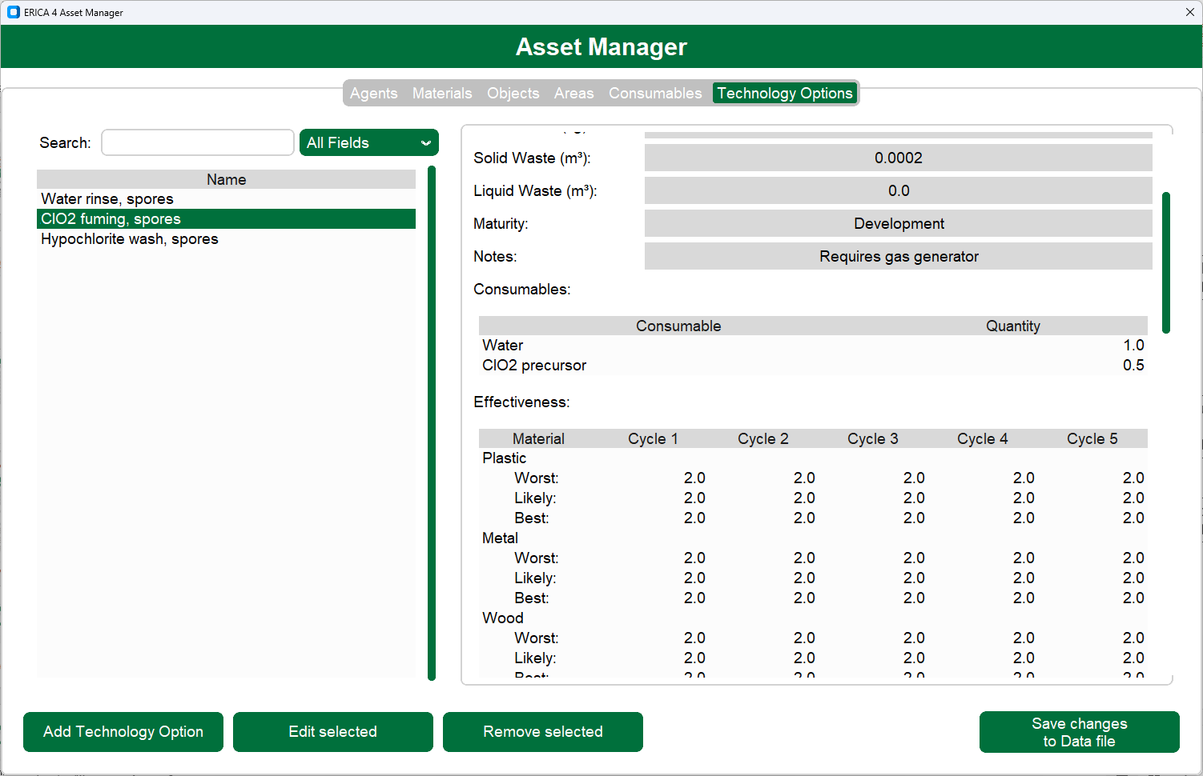
The ERICA Toolset
ERICA is a completely bespoke toolset to define and model the CBR recovery process.
It is written in Python, with the following features:
  User interface, to guide users during data entry.
  Interfaces with SQL databases.
  Displays relevant data and calculations to assist the analyst in creating a recovery plan.
  Provides initial estimates of time, cost, waste, etc.
  Discrete-event simulation engine, to simulate the time-dependent features of recovery.
  Interactive results dashboard.
The toolset is split into two applications:
  Data Management – preparing the simulation data.
  Site Planning – building and simulating recovery plans.

Slide 12



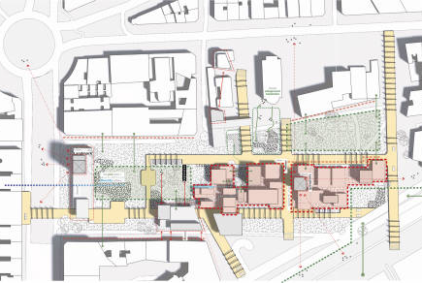



The Database of “Building Blocks”
How can ERICA reduce the analyst’s burden to define a site?
  Construct a generic data set ahead of an incident.
  These building blocks can be put together very quickly for a rough initial estimate.
  A more custom site can be constructed by customising the generic set, in slower time.
ERICA has a custom UI and SQL database to allow users to record, retrieve and audit all the data it uses.
Site
Zone
Area
Object
Material
Fridge #1
Countertop #8
Countertop #9
Kitchen #1
Microwave #1
Bare wood
Washing mch. #1
Soil
3-bed house #1
x3
Crockery #1
Glassware #3
Bedroom #1
Glassware #1
Brick
3-bed house #2
Lighting #10
Fabric
Street #1
Wall tiles #3
Metal
2-bed house #1
Living room #1
Lino. #6
Glass

Slide 13
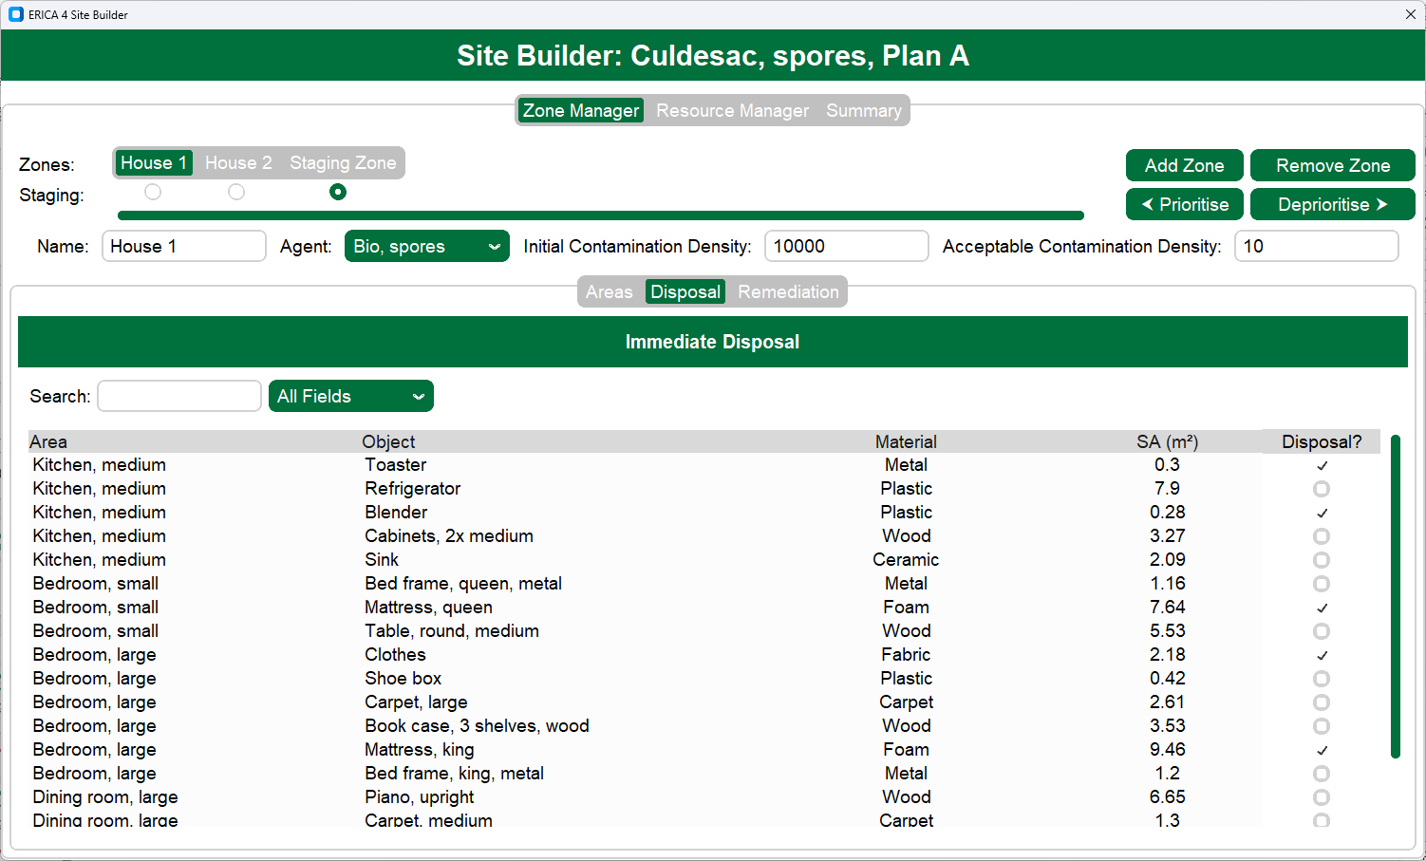
Choosing a Remediation Plan
This is the most complex Activity in recovery process.
ERICA calculates the time, resources, and consumables required for the remediation Activity, based on the selected plan.
Initial disposal Activity:
ERICA displays all Objects in the Site.
Analyst can tick off the items to be immediately disposed of.
The Object list may be filtered by name, Material, etc.
Objects may be sorted, e.g. from smallest to largest.

Slide 14
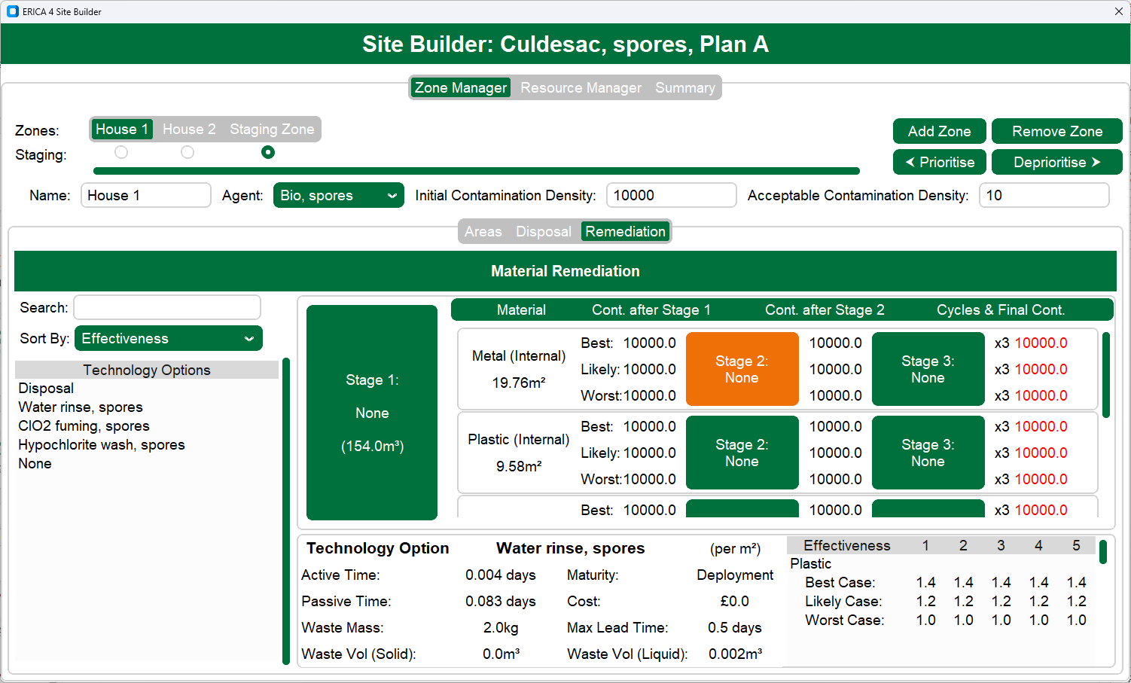
Choosing a Remediation Plan
Remediation Activity:
ERICA calculates the total surface area of remaining Objects, by Material.
  Can select up to 3 different remediation methods per Material.
  On-the-fly calculations showing resulting contamination levels.
  ERICA flags contamination levels above the safe threshold.
ERICA displays all applicable remediation techniques:
  Surface-application vs volume-application.
  Can be sorted by speed, effectiveness, cost, etc.
ERICA displays data of the selected remediation option, to inform the analyst:
  Calculates time, cost and waste when using the selected technique for the selected Material.
  Shows 3-point-estimates of the technique’s effectiveness for the selected Material.
  Flags important considerations, e.g. requires specialist equipment, untested technique, etc.

Slide 15
The Discrete-Event Simulation
After building a site and formulating the remediation strategy, the UI provides as estimate of:
  Time to remediate the site.
  Consumables needed.
  Waste generated.
However, this is simplistic and cannot account for time-based dynamics.
Therefore, the user can then be run through a custom Python discrete-event simulation, to account for more factors:
  Scheduling of the resources that conduct the activities, which may introduce time delays.
  Re-ordering consumables through the supply chain, which may introduce time delays.
  Providing temporal information – e.g. not only total consumables needed, but when they are needed.
Simulation can run multiple times (Monte Carlo) as some input data has 3-point-estimates.

Slide 16










The Discrete-Event Simulation
Planning
Sample collection & processing
Remediation
Site survey
Confirmation sampling
Initial disposal
Short task –
Enough PPE
House #1
House #2
Large task –
Not enough PPE!
Threshold reached –
Resupply ordered
House #3
Resupply arrived
Workers #1
Workers #2
SMEs
Fumigator
PPE
Sample jars
Water
Bleach

Slide 17
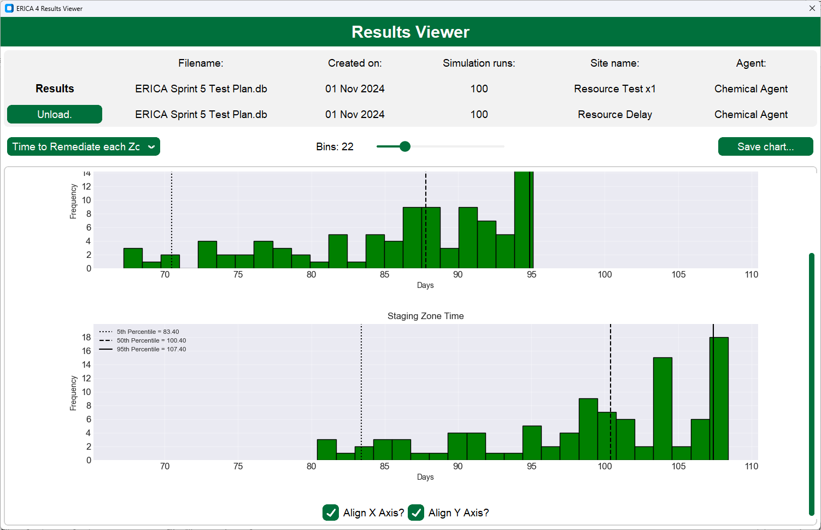
Results Dashboard
Outputs from the discrete-event simulation can be viewed in ERICA’s interactive results dashboard.
All key results can be shown:
  Time to recover the Site,
    and recover each Zone within the Site,
      and Activity for each Zone in the Site.
  Waste generated (liquid and solid, m³ and ISO container equivalent), and when.
  Number of each consumable used, and when.
  Resource utilisation.
  Activity delays, and the reason for the delay.
Two results files can be compared side-by-side.
Charts can be exported for use in reports.

Slide 18
Results Dashboard
Total Consumables used
Consumables used over time
Consumable #1 used
Consumable #1 used
300
250
200
150
100
50
0
600
300
0
None
Approx. 60
450
150
Frequency
Number
Consumable
variation
Time variation
Different
order
Approx. 500
300
350
400
450
500
550
600
0
30
60
90
120
150
180
Number
Days
Not an ERICA output – for illustrative purposes only

Slide 19
Looking Ahead
Sagentia Defence delivered the current version of the ERICA toolset in early 2025, including training and documentation.
We will support Dstl and DEFRA in implementing the use of ERICA:
  Further training and support.
  Further testing, including validation trials with real-world CBR incident data.
  Deploying further improvements to the UI and functionality, through user feedback.
  Importing / interfacing with external databases and assisting in creating the ERICA dataset.
  Potential to extend ERICA to similar areas (e.g. non-civil CBR recovery).

Slide 20
Contacts
ERICA toolset and simulation: Mike Walker (mike.walker@sagentiadefence.com)
Dstl, NTAG-R: Kesh Patel (vpatel@dstl.gov.uk)
DEFRA, NTAG-R: cbrnrecovery@defra.gov.uk

